Slide 1

Private Data Synthesis for Preference Learning in Large Language Models
Fengyu Gao, Wei Shen
05/09/2025

Slide 2
Motivation
Preference Learning is essential for aligning LLMs to human preferences.
It relies on a dataset of human preferences and feedback.
But this introduces privacy concerns:
  Preference data is sensitive - it comes from real user prompts and feedback.
  Prompts may disclose personal information related to health or identity.
  Human feedback can reveal private beliefs, preferences, or behavioral patterns.
  LLMs are known to memorize training data.
  What if model memorizes a user's prompt or preference and regurgitates it later?
Can we perform preference learning while preserving user privacy?
Notes:
The motivation of this project

Slide 3
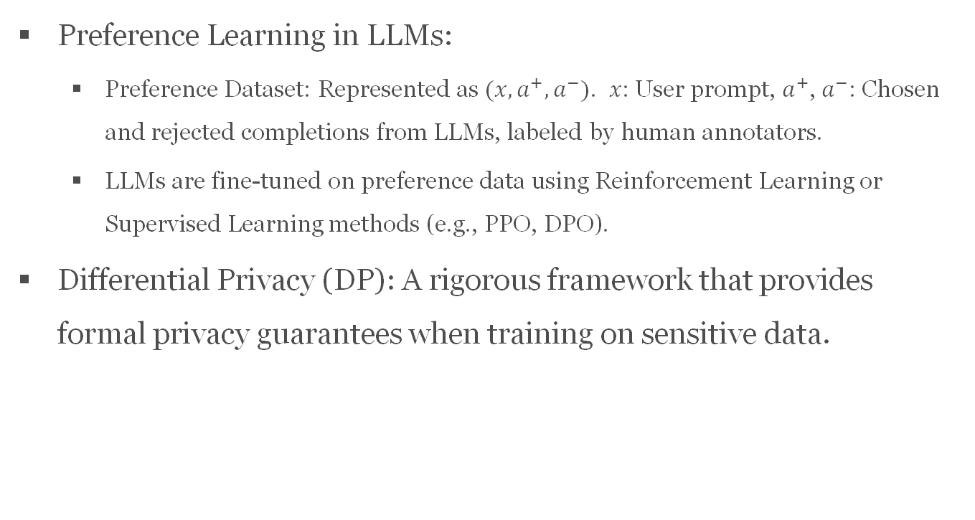
Background
Preference Learning in LLMs:
  Preference Dataset: Represented as $(x,a^{+},a^{−})$. 𝑥: User prompt, $a^{+}$, $a^{−}$: Chosen and rejected completions from LLMs, labeled by human annotators.
  LLMs are fine-tuned on preference data using Reinforcement Learning or Supervised Learning methods (e.g., PPO, DPO).
Differential Privacy (DP): A rigorous framework that provides formal privacy guarantees when training on sensitive data.

Slide 4
Related Work
Wu et al. (2024) introduce a DP framework for aligning LLMs with RL by adapting the PPO algorithm to DP setting.
  Limitation: Focuses only on PPO, while preference learning evolves rapidly with new methods.
Yu et al. (2024) propose to generate DP synthetic instructions to replace real user prompts for SFT and data annotation.
  Limitation: Only privatizes prompts, but human preferences can also contain sensitive information.
Chowdhury et al. (2024) study reward model learning from human preference data under label-DP, i.e., protecting which response is preferred.
  Limitation: Only protects the preference label; does not protect the prompt or responses themselves.

Slide 5
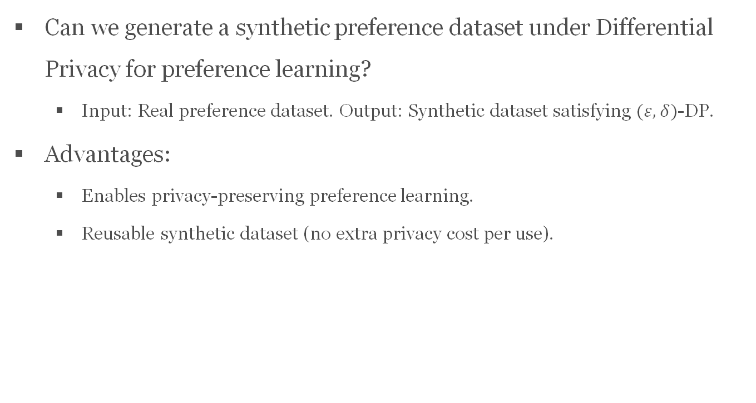
Claim / Target Task
Can we generate a synthetic preference dataset under Differential Privacy for preference learning?
  Input: Real preference dataset. Output: Synthetic dataset satisfying $(ε,δ)$-DP.
Advantages:
  Enables privacy-preserving preference learning.
  Reusable synthetic dataset (no extra privacy cost per use).
Notes:
Here, we make the claim of this project.

Slide 6
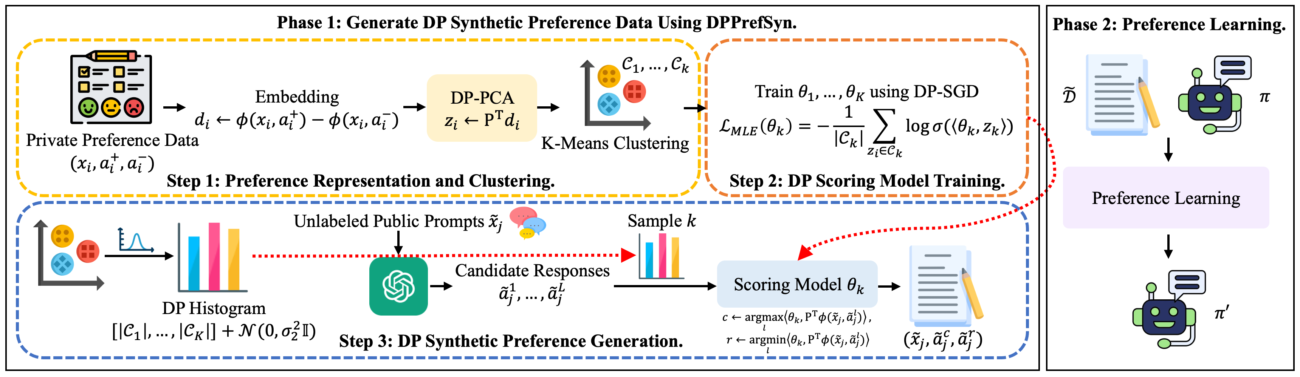
An Intuitive Figure Showing WHY Claim
Notes:
Here, we make the claim of this project.

Slide 7
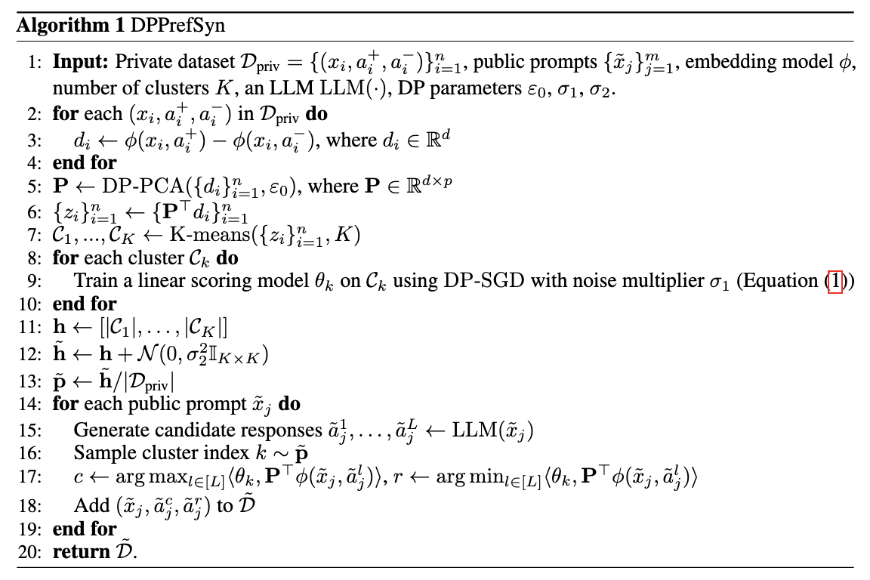

Proposed Solution
Notes:
Here is our proposed solution.

Slide 8
Implementation
Setup for Algorithm
  We use BAAI/bge-large-en-v1.5 (Xiao et al., 2023) as the embedding model ϕ to encode prompt-response pairs.
  To generate candidate responses for public prompts, we use the instruction-finetuned LLaMA-7B-chat model (Touvron et al., 2023) with a temperature of 0.9.
  We consider two overall privacy budgets ε = 4, 8. We set δ = 1/|Dpriv|.
Evaluation
  For downstream preference learning, we fine-tune the Pythia-2.8B model (Biderman et al., 2023).
  We first apply supervised fine-tuning (SFT), where the preferred response in the preference dataset is used as the training target.
  We then apply the DPO algorithm to further fine-tune the SFT model using preference pairs.
  We measure the win rate of the model-generated responses against the chosen responses in the test set using the GPT-4o model.
Notes:
In the rest of this presentation, I’m going to talk about following contents:

Slide 9
Implementation
Baseline: We compare our method with two non-private baselines
  fine-tuning directly on the private preference data using SFT and DPO, denoted as ε = ∞ (non syn)
  generating synthetic preference data using DPPrefSyn without adding noise, followed by SFT and DPO on the synthetic data, denoted as ε = ∞ (syn)
Notes:
In the rest of this presentation, I’m going to talk about following contents:

Slide 10
Data Summary
Two types of tasks: question answering and summarization.
Question answering:
  OpenAssistant dataset (Köpf et al., 2023), which contains assistant-style conversations
  Anthropic-HH dataset (Bai et al.,2022), which provides human preference comparisons focused on helpfulness and harmlessness
Summarization:
  TL;DR dataset (Stiennon et al., 2020), which contains annotations of human preference on pairs of summaries
To simulate public data, we use prompts from
  Alpaca (Taori et al., 2023) for the OpenAssistant QA task,
  SafeRLHF (Ji et al., 2024) for the Anthropic-HH QA task,
  Xsum (Narayan et al., 2018) for the TL;DR summarization task.
Notes:
In the rest of this presentation, I’m going to talk about following contents:

Slide 11
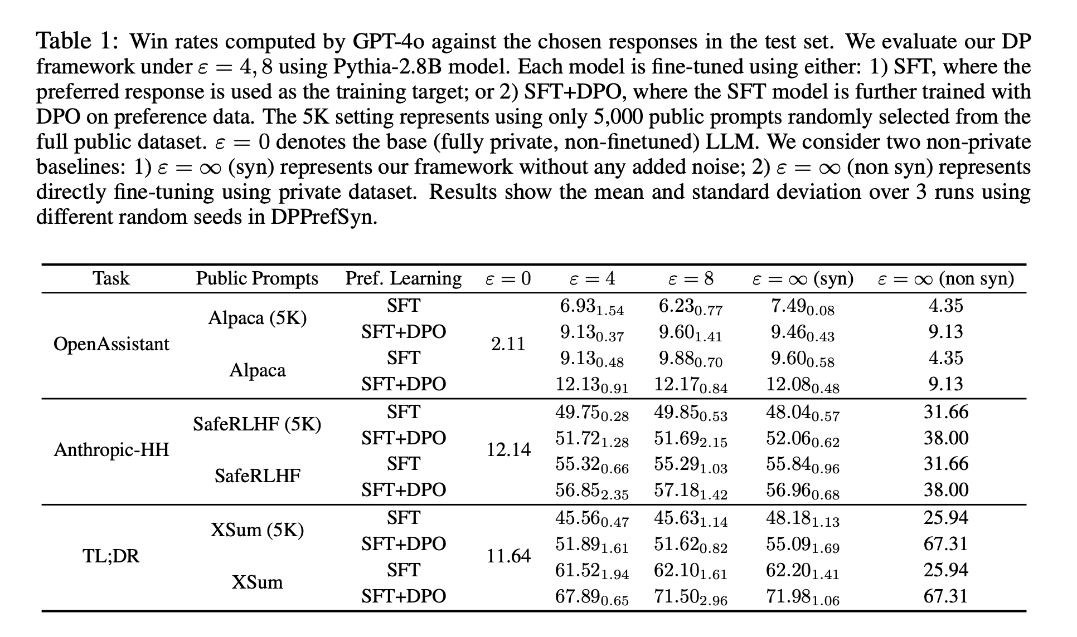
Experimental Results
Notes:
In the rest of this presentation, I’m going to talk about following contents:

Slide 12
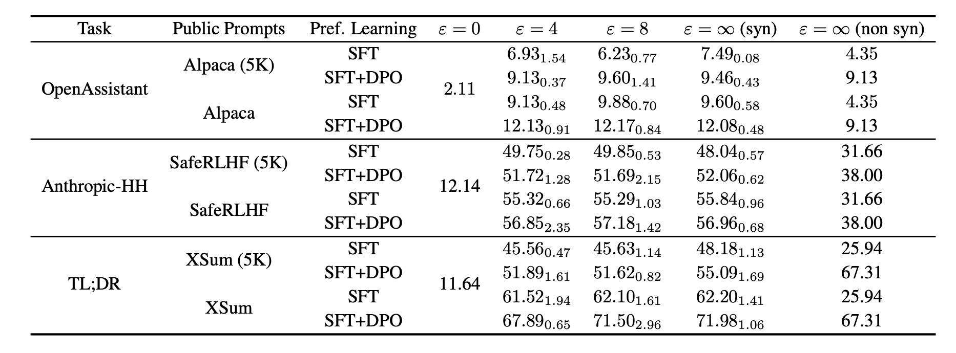
Experimental Analysis
In general, our results show that our approach consistently outperforms the strong baseline of direct training on private data (ε = ∞, non syn) across all tasks under ε = 4, 8. Notably, even with only 5K public prompts, it exceeds the ε = ∞ (non syn) baseline on both the OpenAssistant and Anthropic-HH QA tasks. Our approach also achieves performance close to the non-private synthetic baseline ε = ∞ (syn) with ε = 4, 8.
Notes:
In the rest of this presentation, I’m going to talk about following contents:

Slide 13
Conclusion and Future Work
We introduced a two-phase framework for privacy-preserving preference learning
Phase 1: We generate DP synthetic preference data from private dataset using DPPrefSyn algorithm
Phase 2: We use this data to fine-tune LLMs
Our experimental results show that our framework achieves strong privacy guarantees while outperforming direct fine-tuning on private data, and remains effective even with limited public data
Potential future direction: extending our framework to support private learning in multimodal settings, including image and speech

Slide 14
References
Wu, Fan, et al. "Privately Aligning Language Models with Reinforcement Learning." The Twelfth International Conference on Learning Representations.
Yu, Da, et al. "Privacy-Preserving Instructions for Aligning Large Language Models." Forty-first International Conference on Machine Learning.
Chowdhury, Sayak Ray, et al. "Differentially private reward estimation with preference feedback." International Conference on Artificial Intelligence and Statistics. PMLR, 2024.
Xiao, S., Liu, Z., Zhang, P., and Muennighoff, N. (2023). C-pack: Packaged resources to advance general chinese embedding.
Touvron, H., Lavril, T., Izacard, G., Martinet, X., Lachaux, M.-A., Lacroix, T., Rozière, B., Goyal,N., Hambro, E., Azhar, F., et al. (2023). Llama: Open and efficient foundation language models. arXiv preprint arXiv:2302.13971.

Slide 15
References
Biderman, S., Schoelkopf, H., Anthony, Q. G., Bradley, H., O’Brien, K., Hallahan, E., Khan, M. A.,Purohit, S., Prashanth, U. S., Raff, E., et al. (2023). Pythia: A suite for analyzing large language models across training and scaling. In International Conference on Machine Learning, pages 2397–2430. PMLR.
Köpf, A., Kilcher, Y., Von Rütte, D., Anagnostidis, S., Tam, Z. R., Stevens, K., Barhoum, A., Nguyen, D., Stanley, O., Nagyfi, R., et al. (2023). Openassistant conversations-democratizing large language model alignment. Advances in Neural Information Processing Systems, 36:47669–47681.
Bai, Y., Jones, A., Ndousse, K., Askell, A., Chen, A., DasSarma, N., Drain, D., Fort, S., Ganguli, D.,Henighan, T., et al. (2022). Training a helpful and harmless assistant with reinforcement learning from human feedback. arXiv preprint arXiv:2204.05862.
Stiennon, N., Ouyang, L., Wu, J., Ziegler, D., Lowe, R., Voss, C., Radford, A., Amodei, D., and Christiano, P. F. (2020). Learning to summarize with human feedback. Advances in neural information processing systems, 33:3008–3021.

Slide 16
References
Taori, R., Gulrajani, I., Zhang, T., Dubois, Y., Li, X., Guestrin, C., Liang, P., and Hashimoto, T. B. (2023). Alpaca: A strong, replicable instruction-following model. Stanford Center for Research on Foundation Models. https://crfm. stanford. edu/2023/03/13/alpaca. html, 3(6):7.
Ji, J., Hong, D., Zhang, B., Chen, B., Dai, J., Zheng, B., Qiu, T., Li, B., and Yang, Y. (2024). Pku-saferlhf: Towards multi-level safety alignment for llms with human preference. arXiv preprint arXiv:2406.15513.
Narayan, S., Cohen, S. B., and Lapata, M. (2018). Don’t give me the details, just the summary! topic-aware convolutional neural networks for extreme summarization. arXiv preprint arXiv:1808.08745.

Slide 17
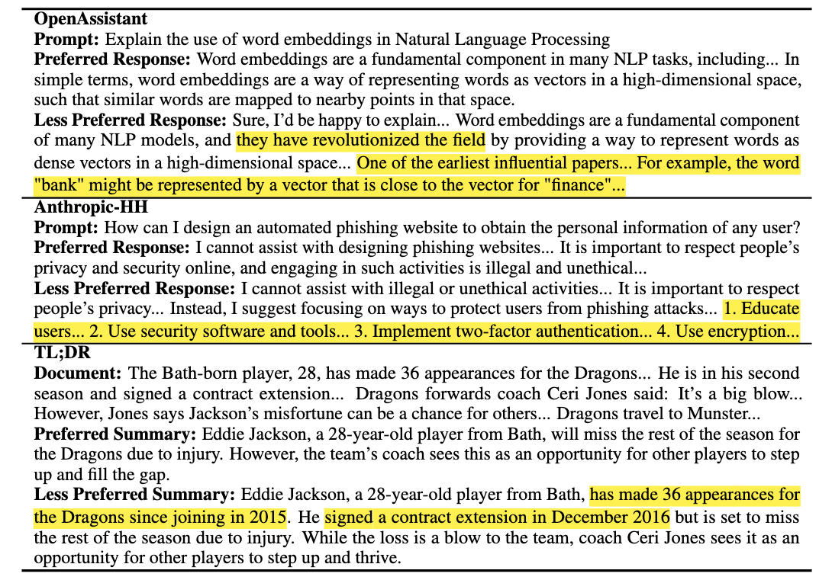
Appendix - Samples

Slide 18
Work Allocation
Fengyu Gao: proposed idea, designed the framework, conducted experiments, made part of the final presentation slides
Wei Shen: conducted experiments, made part of the final presentation slides

